Slide 1

OBJECT DETECTION USING THERMAL IMAGES
BTP Code: B23RVP01
Team members
E.Jaswanth Krishna - S20200020257
A.Gopal Reddy - S20200020248
Mentor -Dr Raja Vara Prasad Y

Slide 2
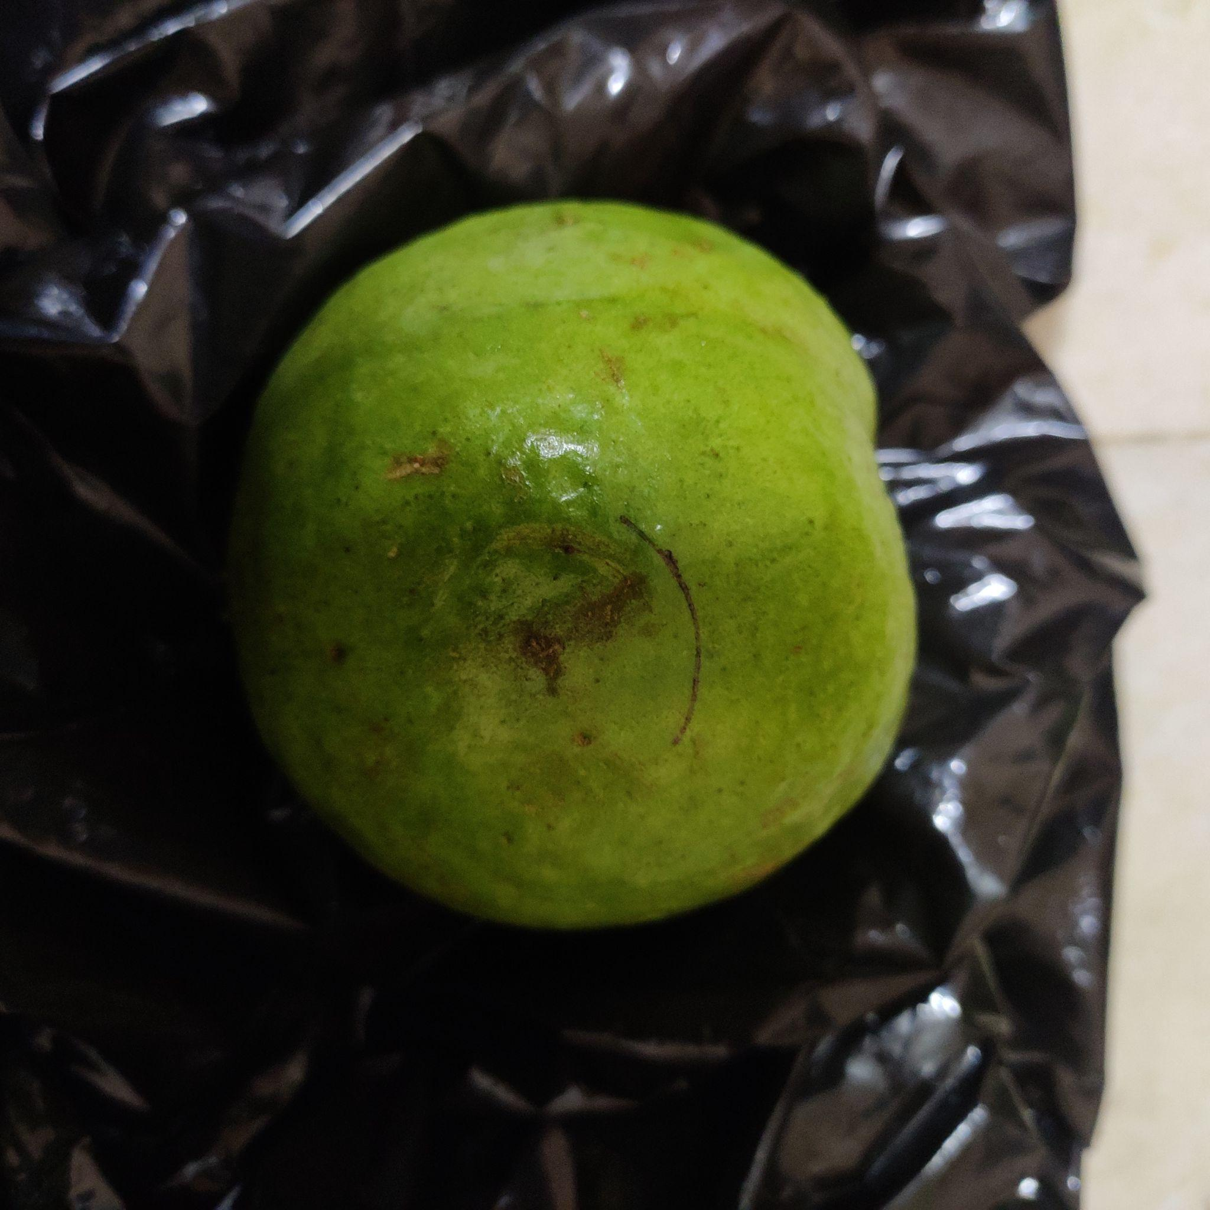
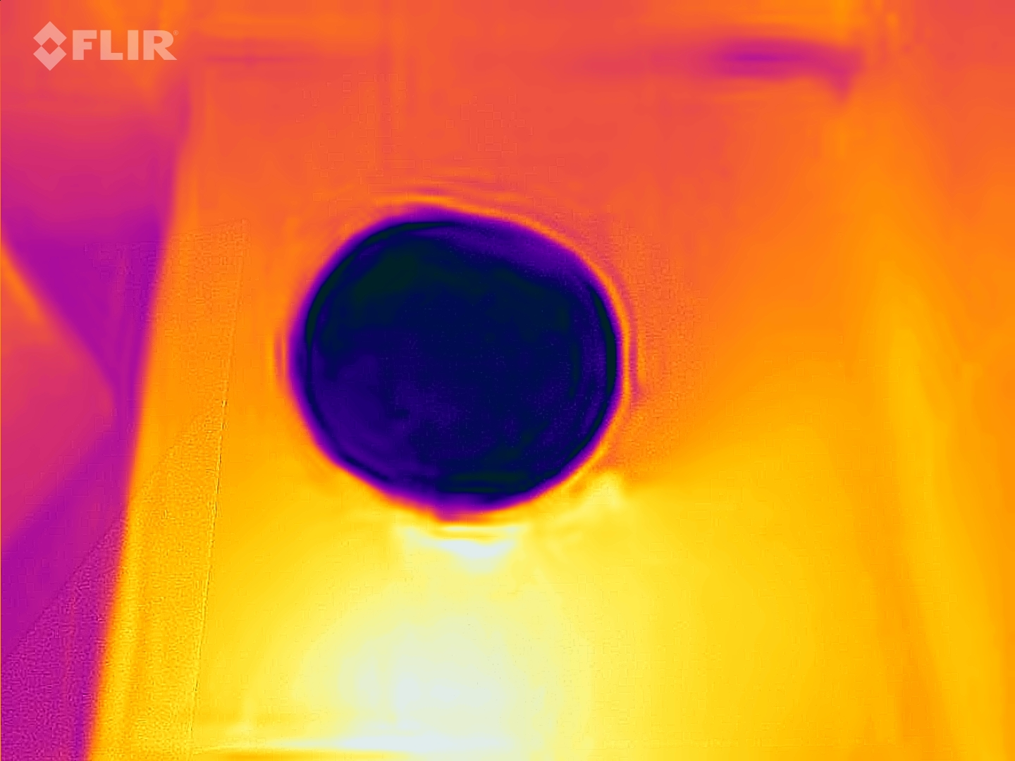
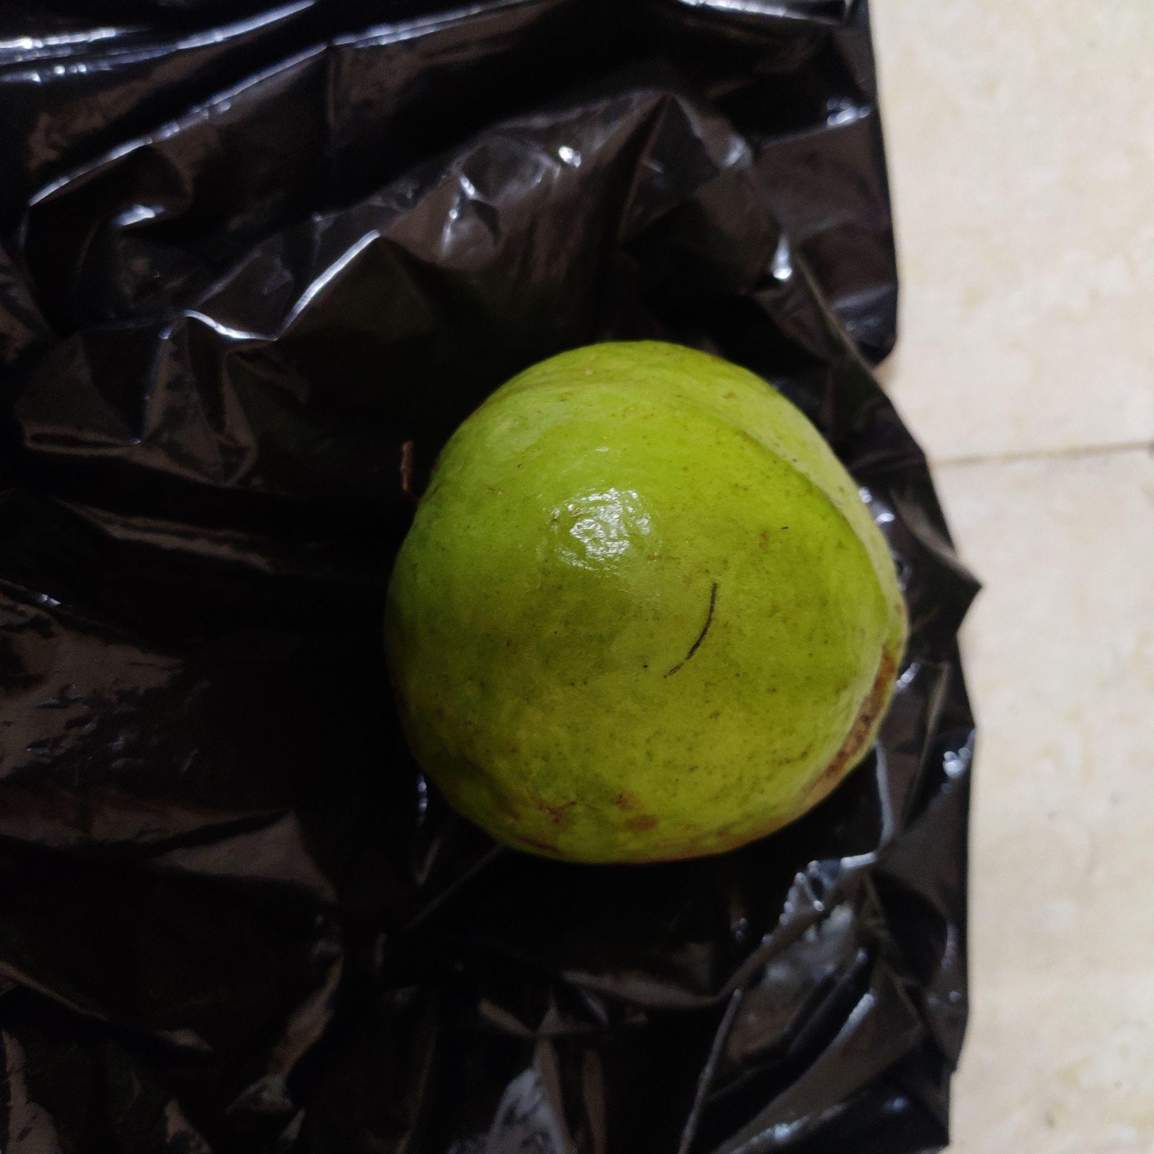
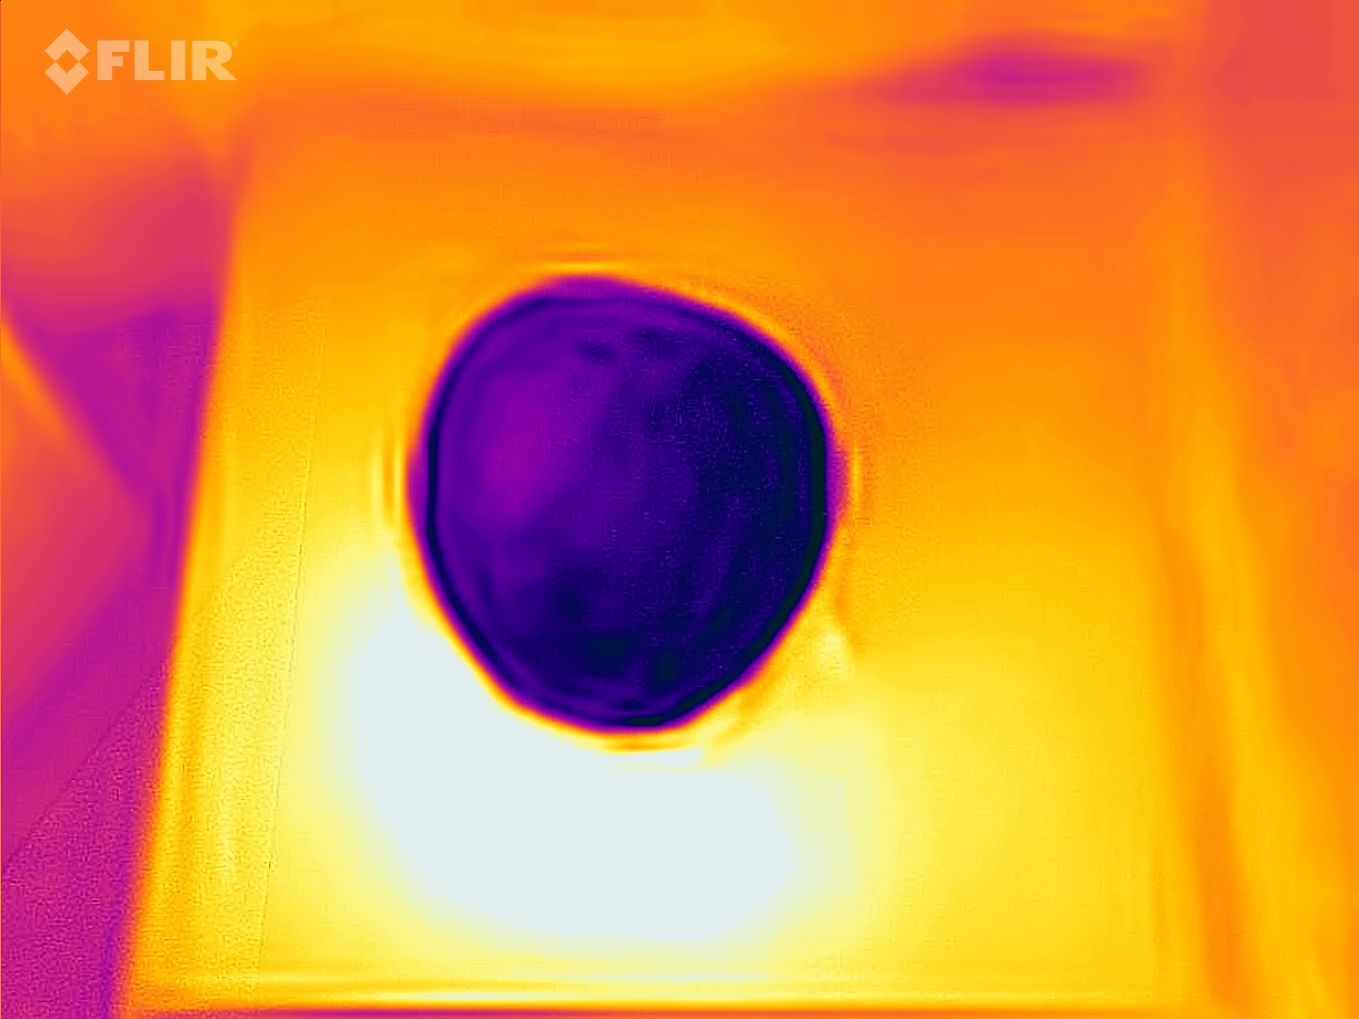
Motivation
Thermal images capture the temperature of the objects in the scene, which is not possible with RGB images.
Thermal images can be used to detect objects that are difficult to see in RGB images, such as animals in a forest or people in the dark
Dataset

Slide 3
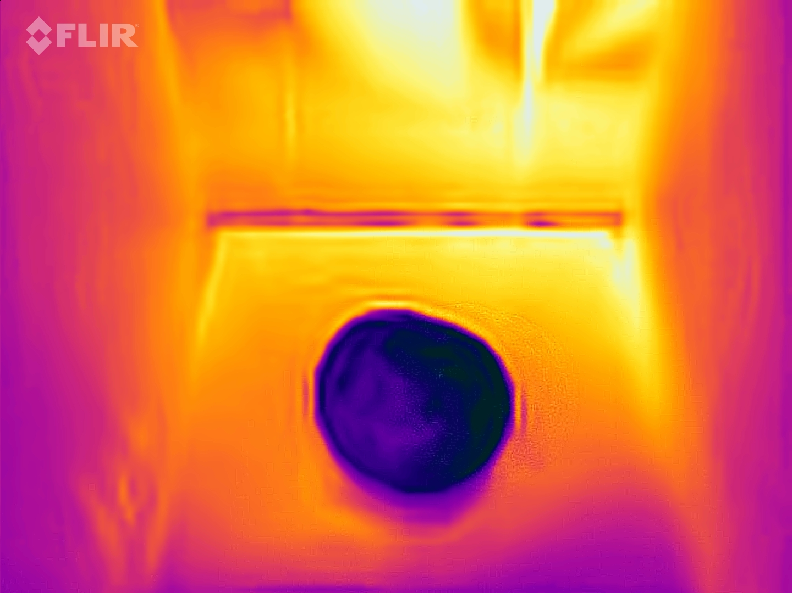
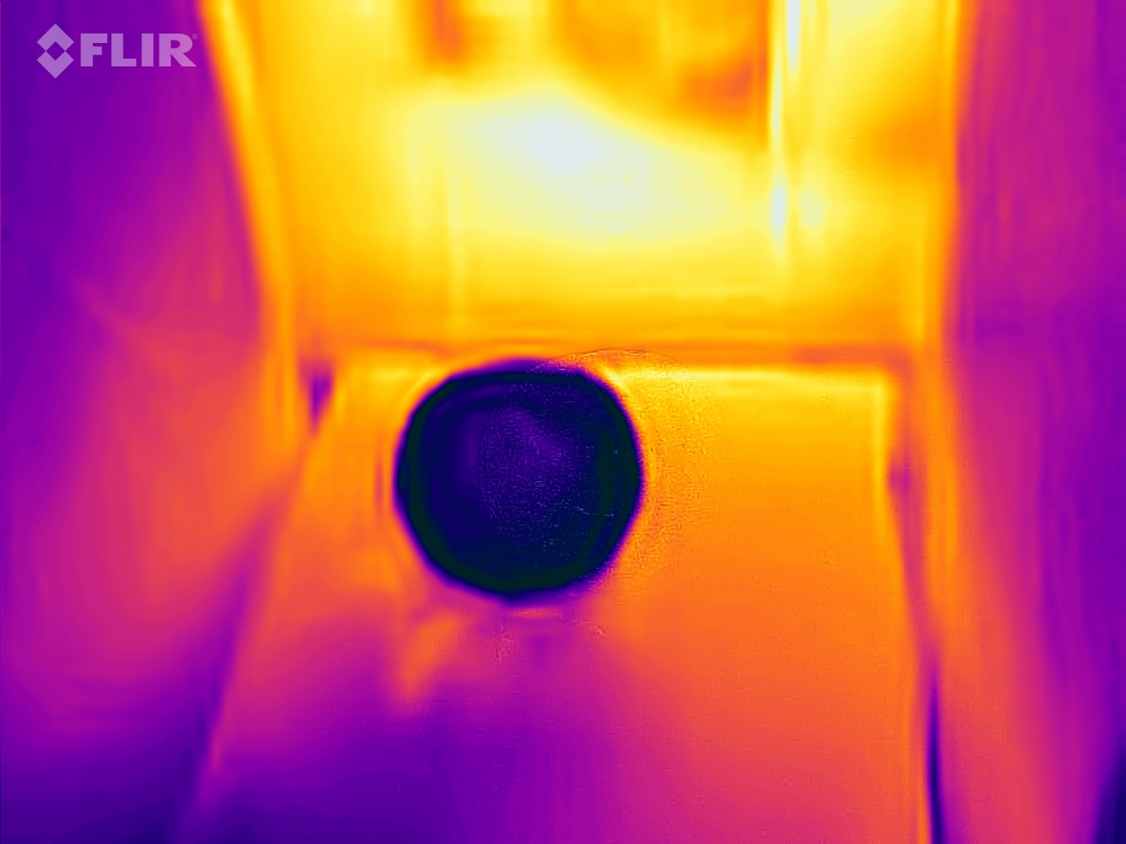
Guava Thermal dataset
Dataset | Images | Percentage
Test | 430 | 87%
Validation | 41 | 8%
Test | 26 | 5%
Ripen Guava
Data Augmentation :
Resize: Stretch to 640x640
Flip: Horizontal, Vertical
90° Rotate: Clockwise, Counter-Clockwise, Upside Down
Unripe Guava
Dataset

Slide 4
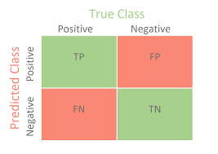
Performance Matrix
PRECISION= true positives /(true positives + false positives)
RECALL = true positives / (true positives + false negatives)
F1 SCORE= 2 * (precision * recall) / (precision + recall)
Performance Matrix

Slide 5
Classification using ML
ML models provide consistent and objective decisions since they apply the same rules to all data points, reducing human bias and errors in the classification process.
ML allows for automated feature selection and engineering, reducing the need for domain-specific knowledge and enabling the model to extract relevant information from raw data.
ML models can adapt and learn from new data, allowing them to continuously improve their classification accuracy over time.

Slide 6
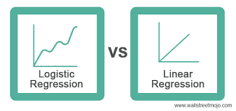
Logistic regression
Logistic Regression is computationally efficient, making it suitable for large datasets and real-time applications.
Training a Logistic Regression model is relatively fast compared to more complex algorithms like deep neural networks.
Logistic Regression can handle both small and large datasets without a significant increase in computational cost.
Logistic regression
Source link

Slide 7
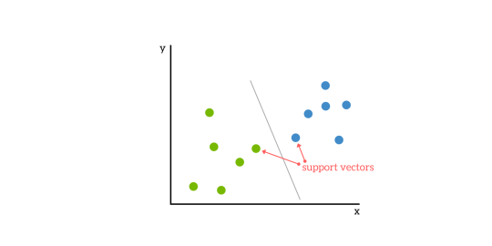
Support Vector Machine
SVMs perform well in high-dimensional feature spaces, making them suitable for problems with many features or complex data.
SVMs aim to find the optimal decision boundary that maximizes the margin between classes, leading to good generalization to unseen data.
SVMs aim to find the global optimum, ensuring that the chosen decision boundary is the best possible one for the given data and kernel function.
SVM
Source link

Slide 8
Machine learning Models Accuracy and Precision
Models | Accuracy(%) | Precision(%)
Logistic Regression | 88.4615 | 91.1243
SVM | 88.4615 | 91.1243
Random Forest | 84.6154 | 85.9890
KNN | 80.7692 | 87.1795
Gradient Boosting | 80.7692 | 81.3054
Naive Bayes | 61.5385 | 63.1868

Slide 9
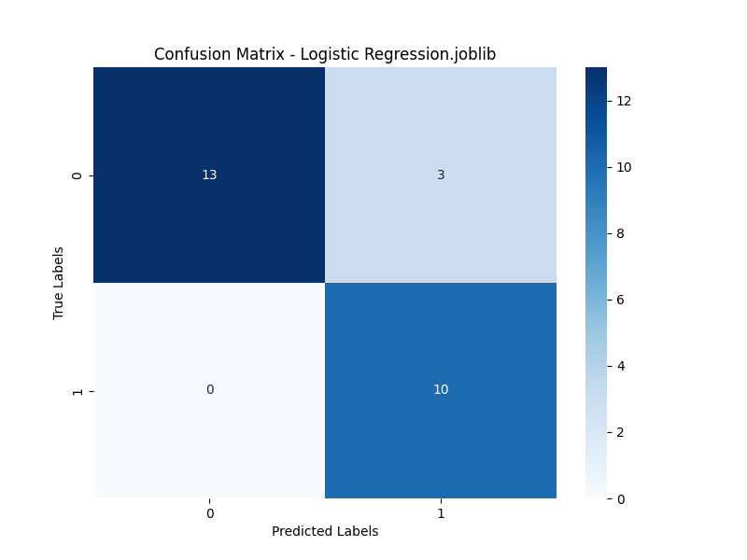

Logistic regression and Support Vector Machine
13
3
13
3
0
10
0
10
Logistic Regression performance matrix
Support Vector Machine performance matrix

Slide 10
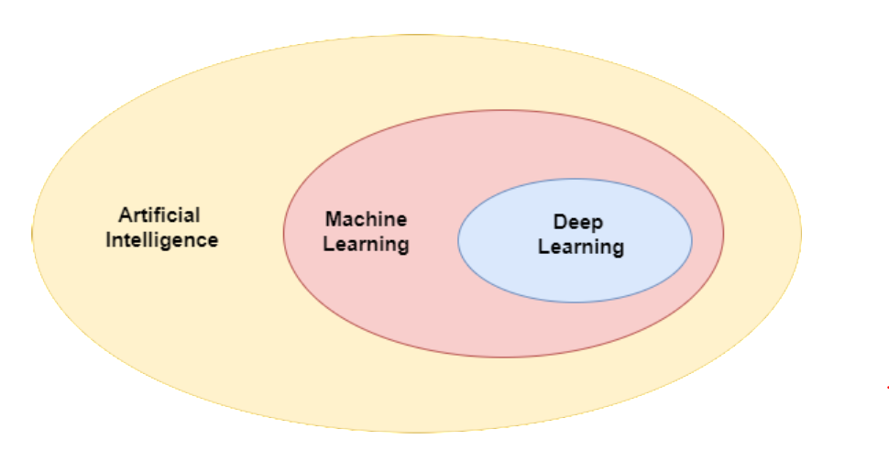
Deep Learning vs Machine Learning
DL can automatically learn and extract relevant features from raw data, eliminating the need for manual feature engineering in ML.
DL models, particularly deep neural networks, can automatically learn hierarchical features from raw data, eliminating the need for manual feature engineering.
DL allows for the fusion of information from multiple sources or modalities, such as text and images, enabling more comprehensive understanding and decision-making.
Source link

Slide 11
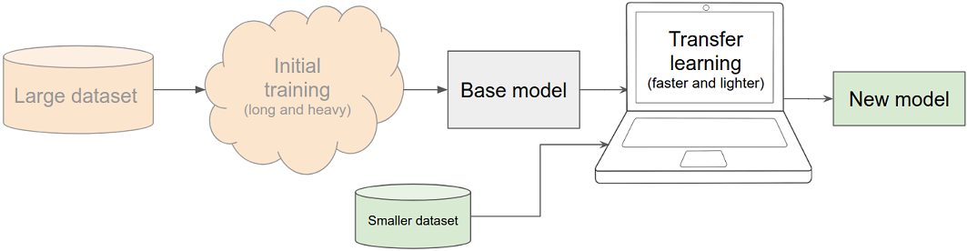
Transfer Learning
Transfer learning is a machine learning technique that involves using a pre-trained model as a starting point for solving a new task.
The process typically involves fine-tuning the pre-trained model on a smaller dataset for the new task, while retaining the weights of the earlier layers of the model.
Source link

Slide 12
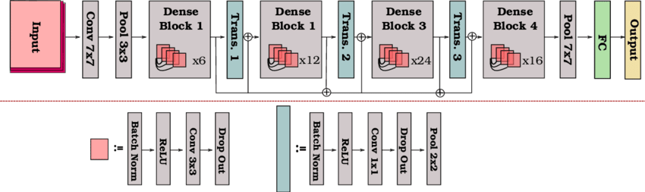
Densenet 121 Architecture
DenseNet introduces the concept of dense connectivity, where each layer is connected to every other layer in a dense block.
This dense connectivity promotes feature reuse and enhances gradient flow, which can lead to better model performance.

Slide 13
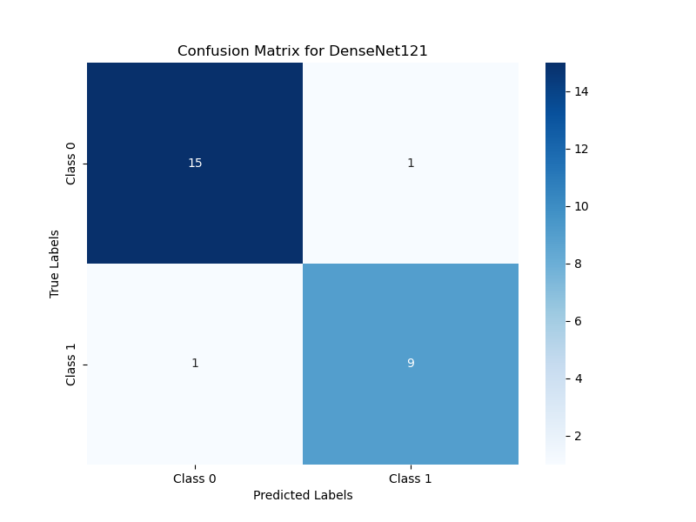
DL Model accuracy using Transfer Learning
Model | Accuracy(%)
DenseNet121 | 92.3077
InceptionV3 | 88.4615
MobileNet | 88.4615
ResNet50V2 | 61.5385
VGG16 | 38.4615
13
1
1
9
Dense Net 121 performance matrix

Slide 14
Conclusion
We utilized the Guava Thermal Image Dataset to perform classification, distinguishing between ripe and unripe specimens using both Machine Learning (ML) and Deep Learning (DL) models.
In the realm of ML, Logistic Regression(LR) and Support Vector Machine (SVM) models achieved an accuracy rate of 88%, while the DenseNet121 DL model achieved an even higher accuracy of 91%.

Slide 15
Timeline of BTP
Stage 4
Introduce a CNN model for classification on Thermal Dataset
4
Stage 3
Classification using ML models and CNN models
Comparing CNN models and ML models
3
Stage 2
Online Dataset(GUAVA)
Object detection using YOLO v8 by Transfer Learning.
2
Stage 1
Literature
Data Collection
1

Slide 16
Future Scope of Evaluation
We intend to introduce a Convolutional Neural Network (CNN) model characterized by its streamlined architecture, achieving high accuracy with a reduced number of layers.
Utilizing a more compact model guarantees a minimal resource footprint on the machine, resulting in faster response times.

Slide 17
Reference Papers
Mohd Ali M, Hashim N, Abd Aziz S, Lasekan O. Characterisation of Pineapple Cultivars under Different Storage Conditions Using Infrared Thermal Imaging Coupled with Machine Learning Algorithms. Agriculture. 2022 Jul 13;12(7):1013.
Naik S, Patel B. Thermal imaging with fuzzy classifier for maturity and size based non-destructive mango (Mangifera Indica L.) grading. In2017 International Conference on Emerging Trends & Innovation in ICT (ICEI) 2017 Feb 3 (pp. 15-20). IEEE.
Bhole V, Kumar A. Mango quality grading using deep learning technique: Perspectives from agriculture and food industry. InProceedings of the 21st annual conference on information technology education 2020 Oct 7 (pp. 180-186).
Bhargava, A. and Bansal, A., 2021. Fruits and vegetables quality evaluation using computer vision: A review. Journal of King Saud University-Computer and Information Sciences, 33(3), pp.243-257.
Ali, M.M., Hashim, N. and Shahamshah, M.I., 2021. Durian (Durio zibethinus) ripeness detection using thermal imaging with multivariate analysis. Postharvest Biology and Technology, 176, p.111517.
Yogesh, Dubey, A.K., Arora, R.R. and Mathur, A., 2021. Fruit defect prediction model (fdpm) based on three-level validation. Journal of Nondestructive Evaluation, 40(2), p.45.

Slide 19
THANK YOU

